Slide 1
Computers & Society
Hyland Hy-Tech Camp

Slide 2
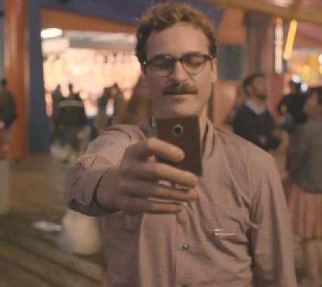
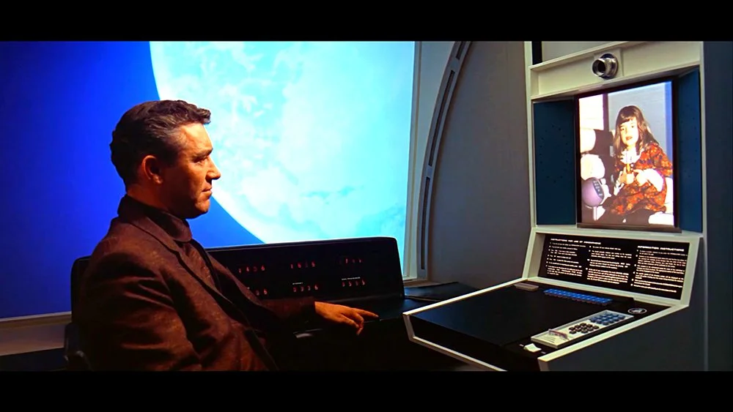
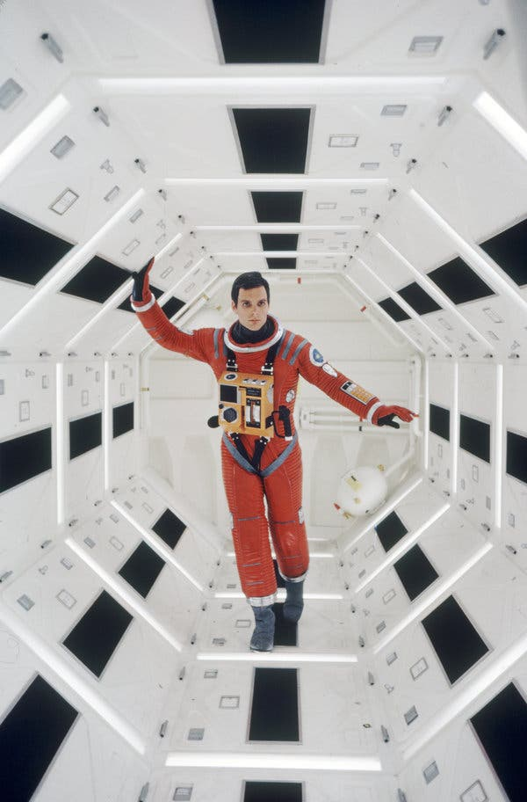
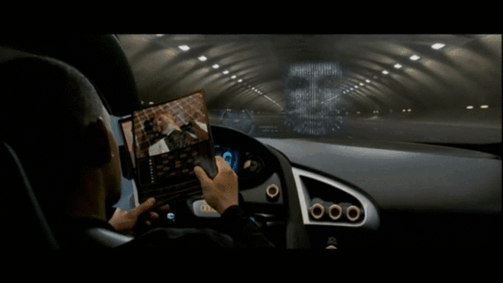
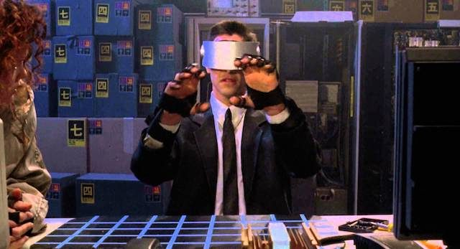
Science Fiction v. Science Itself
Notes:
Ask the students to give examples of science fiction
Note that some ideas that were once science fiction have become a reality:
Video Calls
Self-Driving Cars
A.I. Powered Voice Assistants
Virtual Reality
Space Stations
Ask the students if they recognize where any of these originate:
Video Calls + Space Station – 2001: A Space Odyssey
Self-Driving Cars – I, Robot
A.I. Powered Voice Assistant – Her
Virtual Reality – Johnny Mnemonic
Note that we will explore the impact of these technologies in this presentation

Slide 3
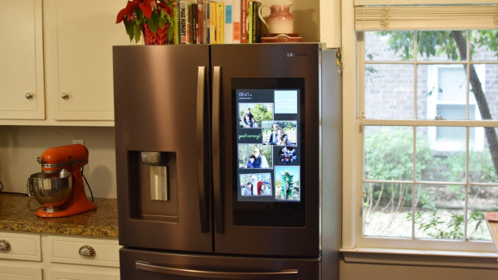
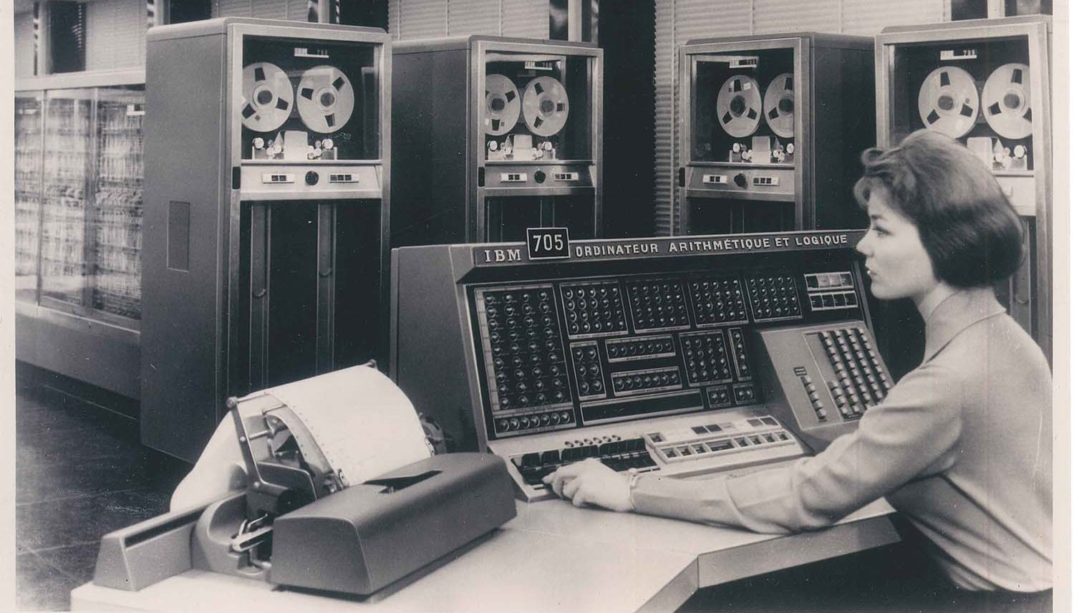
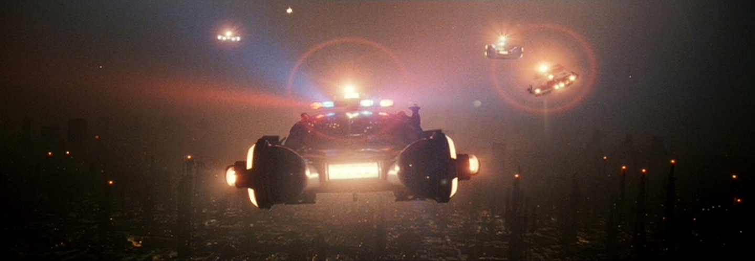
Camp Agenda
Past
How did we get here?
How have computers and other technologies had an impact on society throughout history?
Present
Where are we exactly?
What computer technologies are currently having an impact on society?
Future
Where are we going?
How will emerging technologies enter the mainstream?
What hypothetical technologies could become a reality?
Notes:
Go through the basic sections this presentation will contain
Make sure to note that this camp will only scratch the surface of the history, present day, and potential future of computing technology
We will start with the past – note how far we have come since the early days of computers
We will then move onto the present – we will discuss current technologies and how they are changing things in the world (like having tv screens on fridges)
Then, we will look forward to the future – maybe we will end up living in a dystopia like in Blade Runner (but maybe not)

Slide 4
in History
Computers
How have computers had an impact on us?
Notes:
We will begin by discussing some (keyword: some) of the history of computers

Slide 5
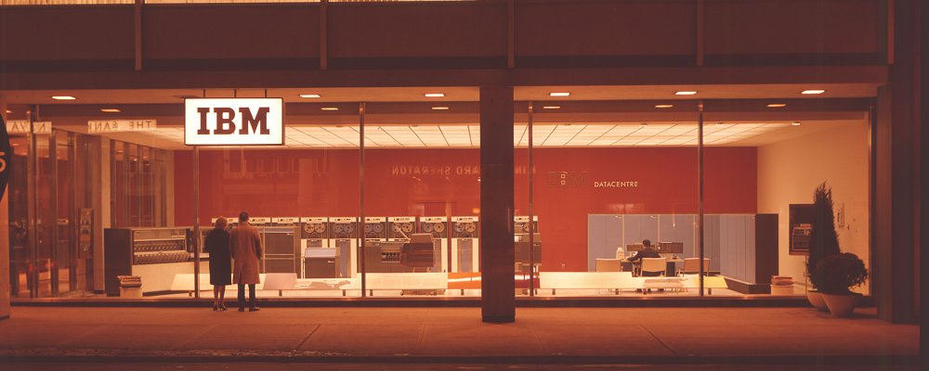
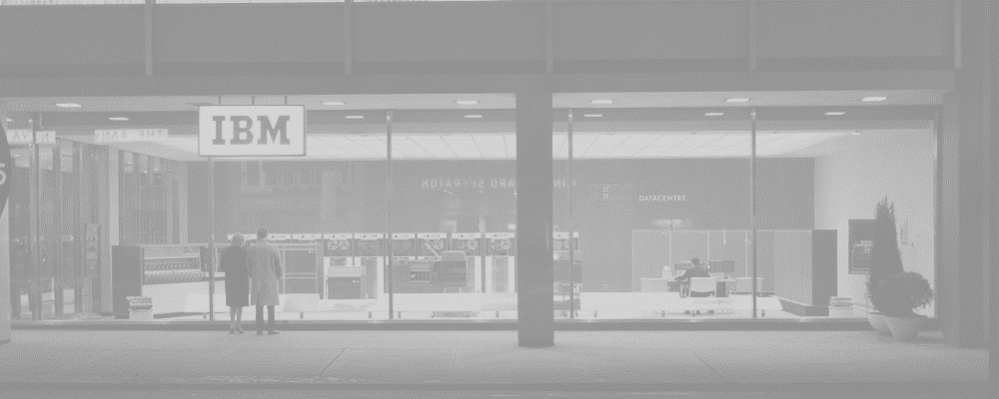
Early Days of
Computers
Giant, complex calculators for science
Various military and academic applications – research and codebreaking
"There is no reason anyone would want a computer in their home.“
Ken Olson
1977
Notes:
No need to spend too long on this slide…
Show the picture of an IBM Data Center, from Toronto 1963
Talk about how originally, computers were basically just giant calculators used for scientific and engineering equations
In the beginning, most applications were for the military (like code-breaking) or for academic studies
In the 1950s, the field of A.I. was born
https://www.computerhistory.org/timeline/computers/

Slide 6
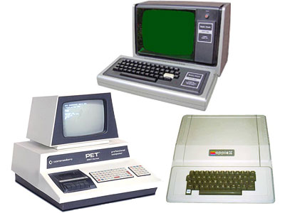
– The Personal Computer
1977
What’s Changed?
Original “PC” Functions
Primitive video games
Word processing
Spreadsheets
Data access/storage
Education
Graphics and Animations
Music composition
General programming
Notes:
No need to spend too long on this slide, other than the discussion portion
The year: 1977
Three very important computers were released this year, that would be dubbed the “Trinity”
Commodore PET (students probably won’t recognize this company)
Apple II (students should recognize this company)
TRS-80 (students might recognize Radio Shack?)
These three computers were the first successful mass-market personal computers – they were “affordable” and “usable”
What could they do? (Ask the students if they have any ideas)
Show some of their functions
Basic video games (with minimal graphics)
Word processing – very primitive version of something like Microsoft Word
Spreadsheets like Microsoft Excel
Database applications
Used to teach students about computers and programming
Could create graphics and animations
Could be used to compose music
Could be used for general programming – there was a ton of interesting and home-brewed software out there!
After going over some of the basic capabilities, ask students how computers now are different

Slide 7

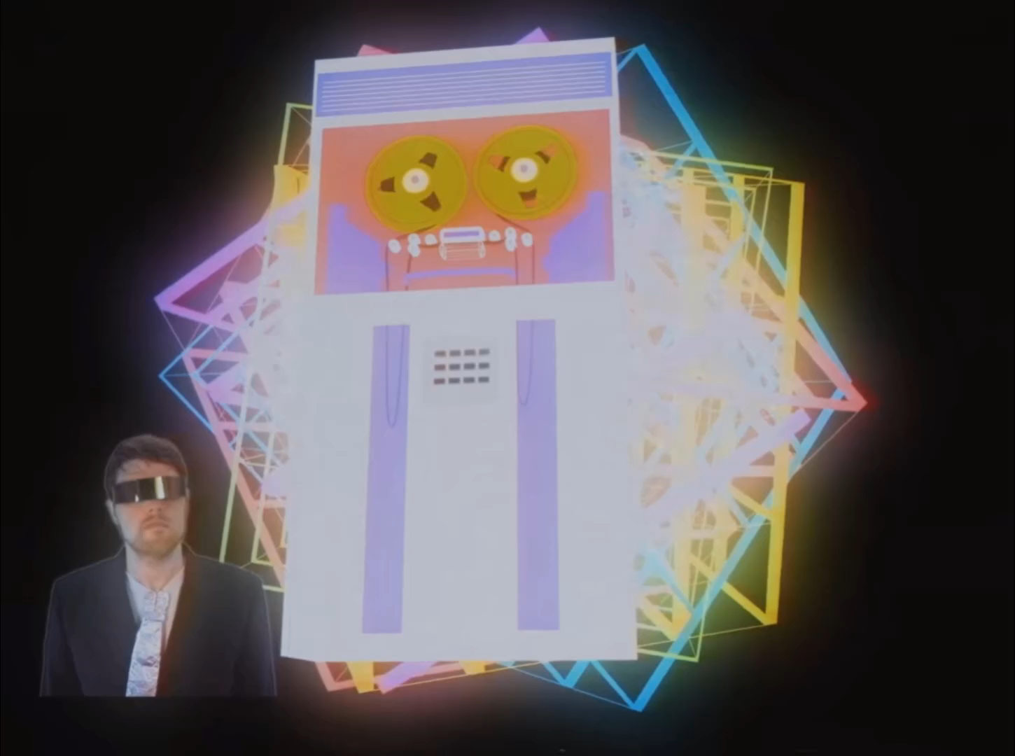



The Internet
(World Wide Web)
Web 1.0
read-only, content created by “admins”
Web 2.0
social web, content created by users
Web 3.0
decentralized web
Notes:
One of the biggest advancements since 1977 is the World Wide Web, or what we know as “The Internet”
Play the video introducing the idea of the internet
Go over Web 1.0 – the first iteration of the web that was “read-only” – content had to be created by those with the means and knowledge to create it. Most users were simply consumers. Mostly static HTML pages rather than dynamic
Go over Web 2.0 – now, pretty much anybody is able to create and share content on the web (Myspace, Twitter). Here, the content was dynamic, the user experience was rich and enveloping, and there was mass participation. It wasn’t only dweebs on the web anymore.
Ask the students if they recognize the logos
Ask the students to name other social media
Briefly touch on Web 3.0 – decentralized ownership of the internet
https://www.youtube.com/watch?v=8We8HChN3a8

Slide 8
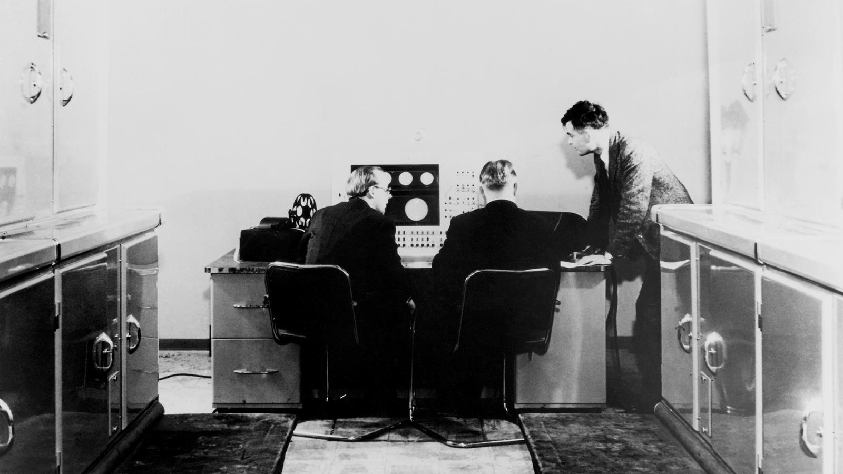
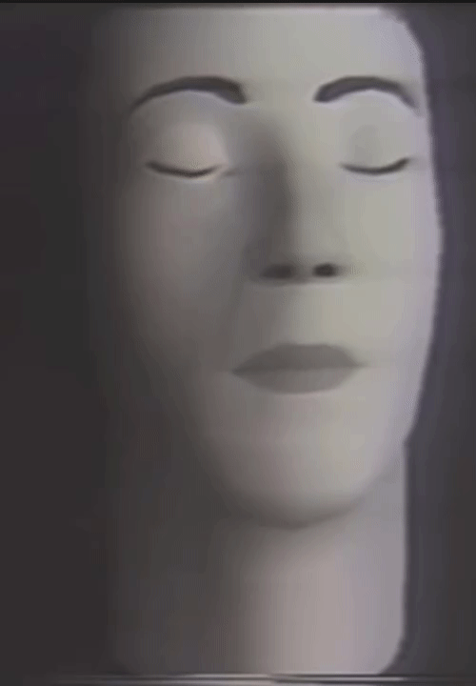
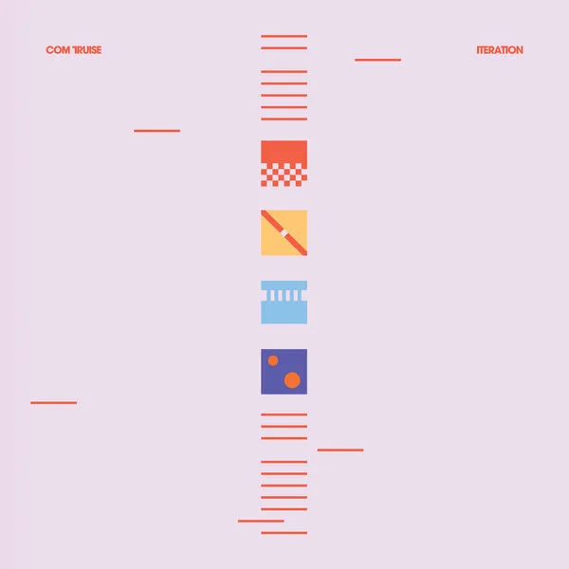
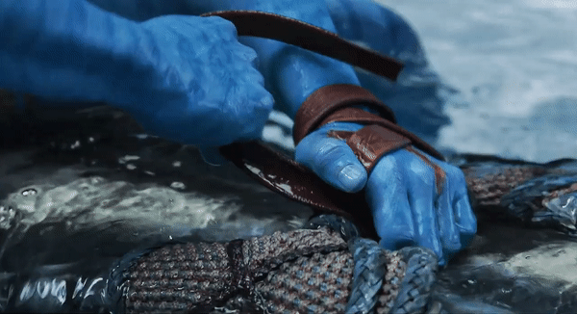
Arts & Entertainment
Electronic Music
Computer-Generated Imagery
from this (1951):
from this (1974):
to this:
to this:
Notes:
Ask the students how computers have impacted arts and entertainment
Show some examples from electronic music
The first recorded instance of computer-generated music – 1951
Fun fact: the computer used to make this music was created by Alan Turing!
60 years later, entire albums can be generated from a computer, like Com Truise – Memory
Most pop music now is created digitally, without any “real” instruments
Show examples of computer-generated imagery
First clip: one of the earliest instances of CGI – from 1974
Second clip: Avatar 2
Entire films are now created using this type of CGI (like the Lion King remake)
https://www.bl.uk/collection-items/earliest-known-recording-of-computer-generated-music
https://comtruise.bandcamp.com/track/memory
https://www.youtube.com/watch?v=SPMFhcC4SvQ
https://twitter.com/boomborks/status/1523993806655614978

Slide 9
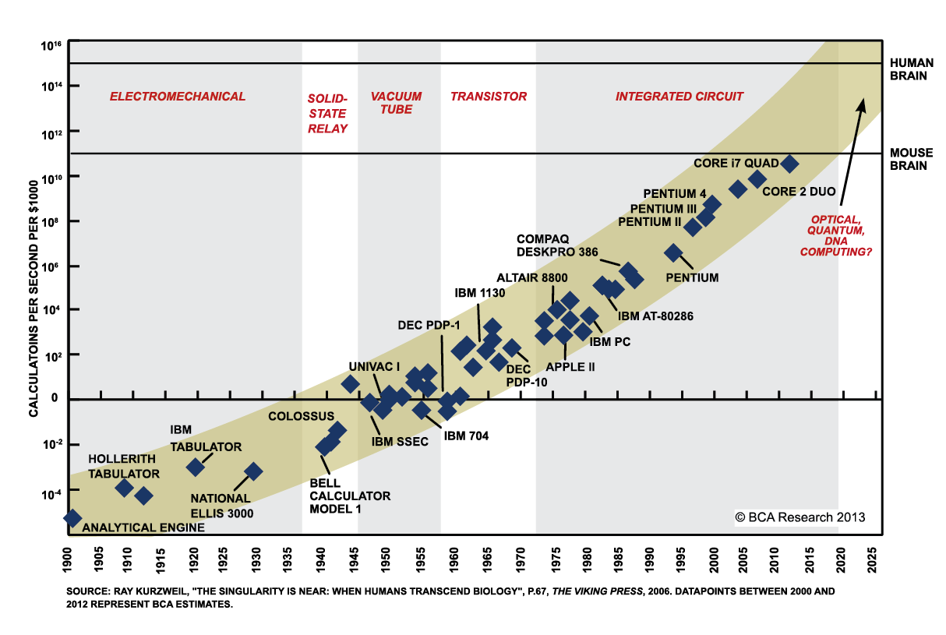
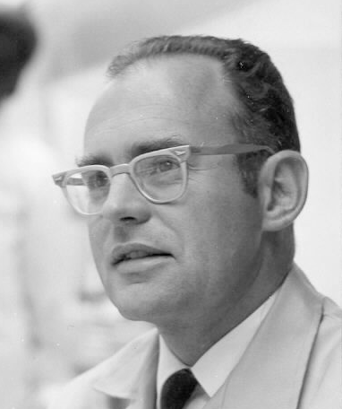
Moore’s Law
“The number of transistors in a dense integrated circuit doubles about every two years”
Gordon Moore in 1965
Notes:
No need to spend too long on this slide…
Obviously, things have advanced quite a bit… and they will continue to do so!
Reveal his quote – ask the students what they think it means
The main idea is that technology keeps getting better and better, at faster and faster rates
Show the graph just quickly explaining it – things were slow in 1900, but they keep getting faster
This idea can be used in support of the “singularity” – but that’s the future
This leads up to now – after all the years of the past, we have entered the present

Slide 10
in the Present
Computers
How do computers impact us today?
Notes:
We will continue by discussing some (keyword: some) of the ways computers impact the present day

Slide 11
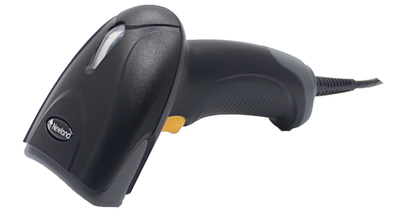
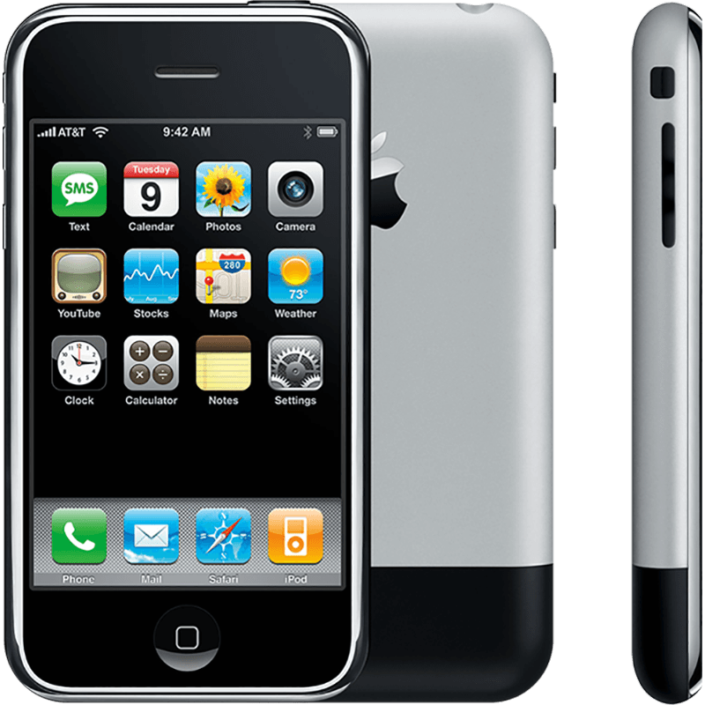
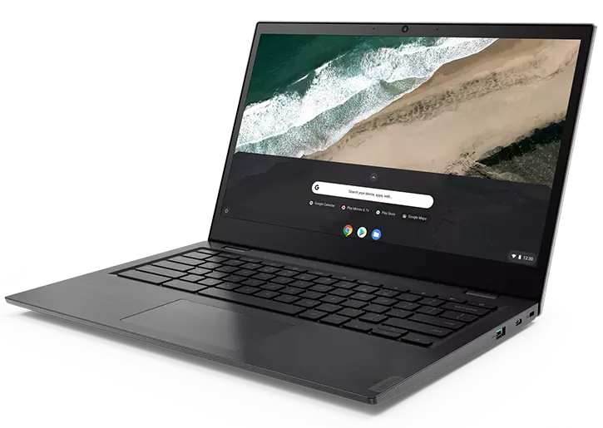
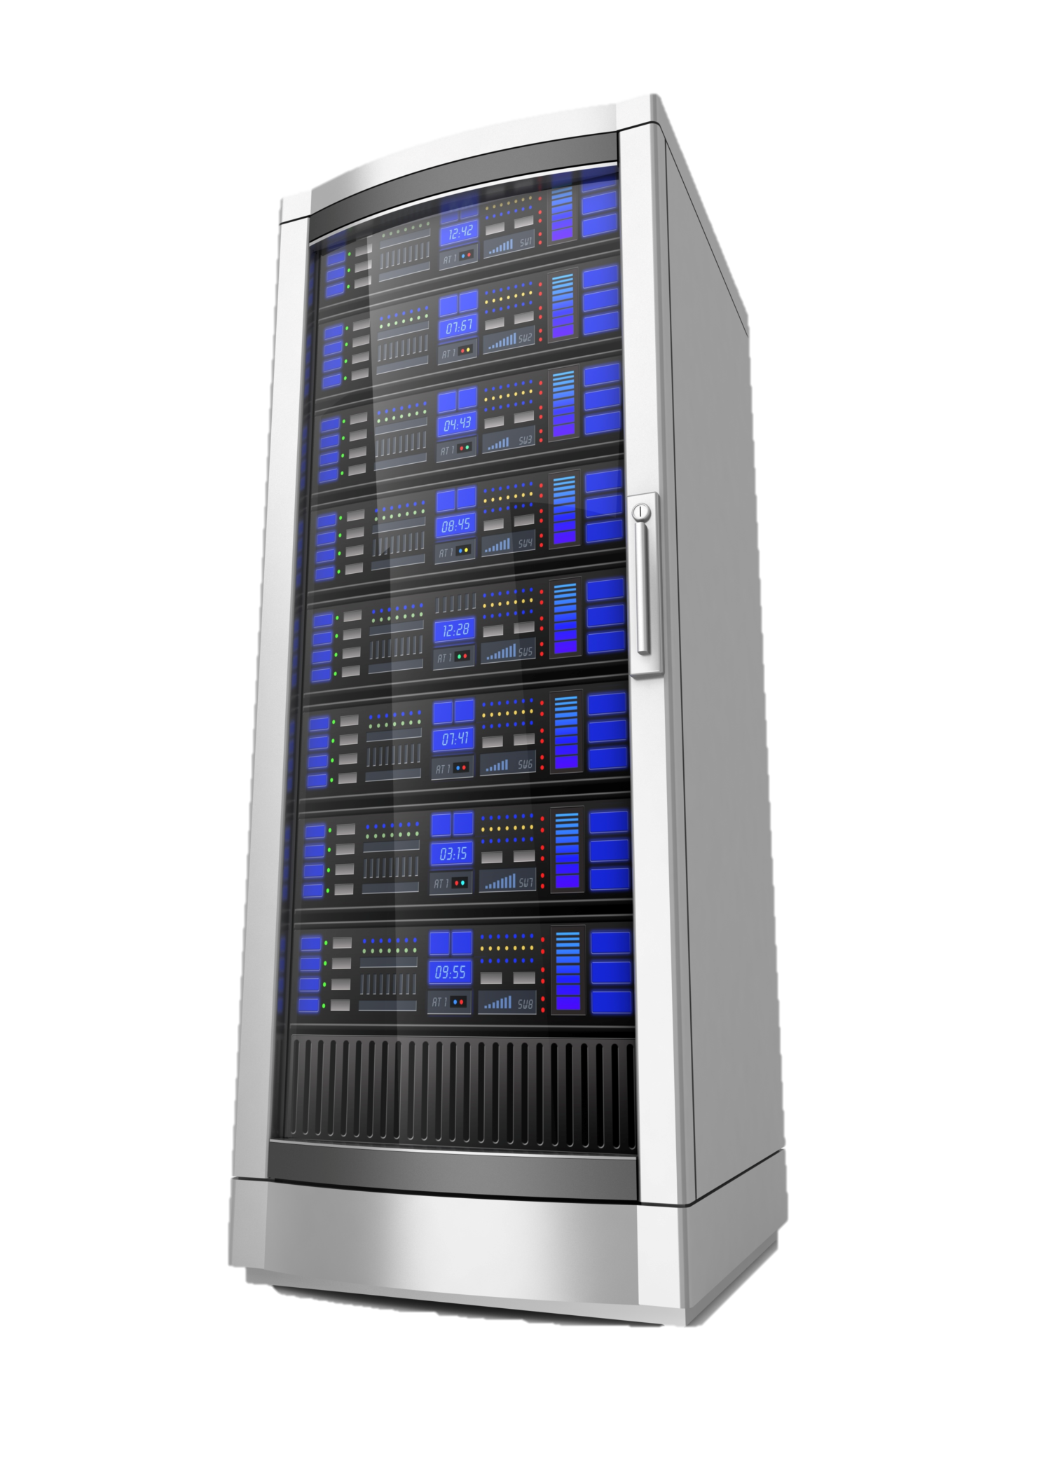

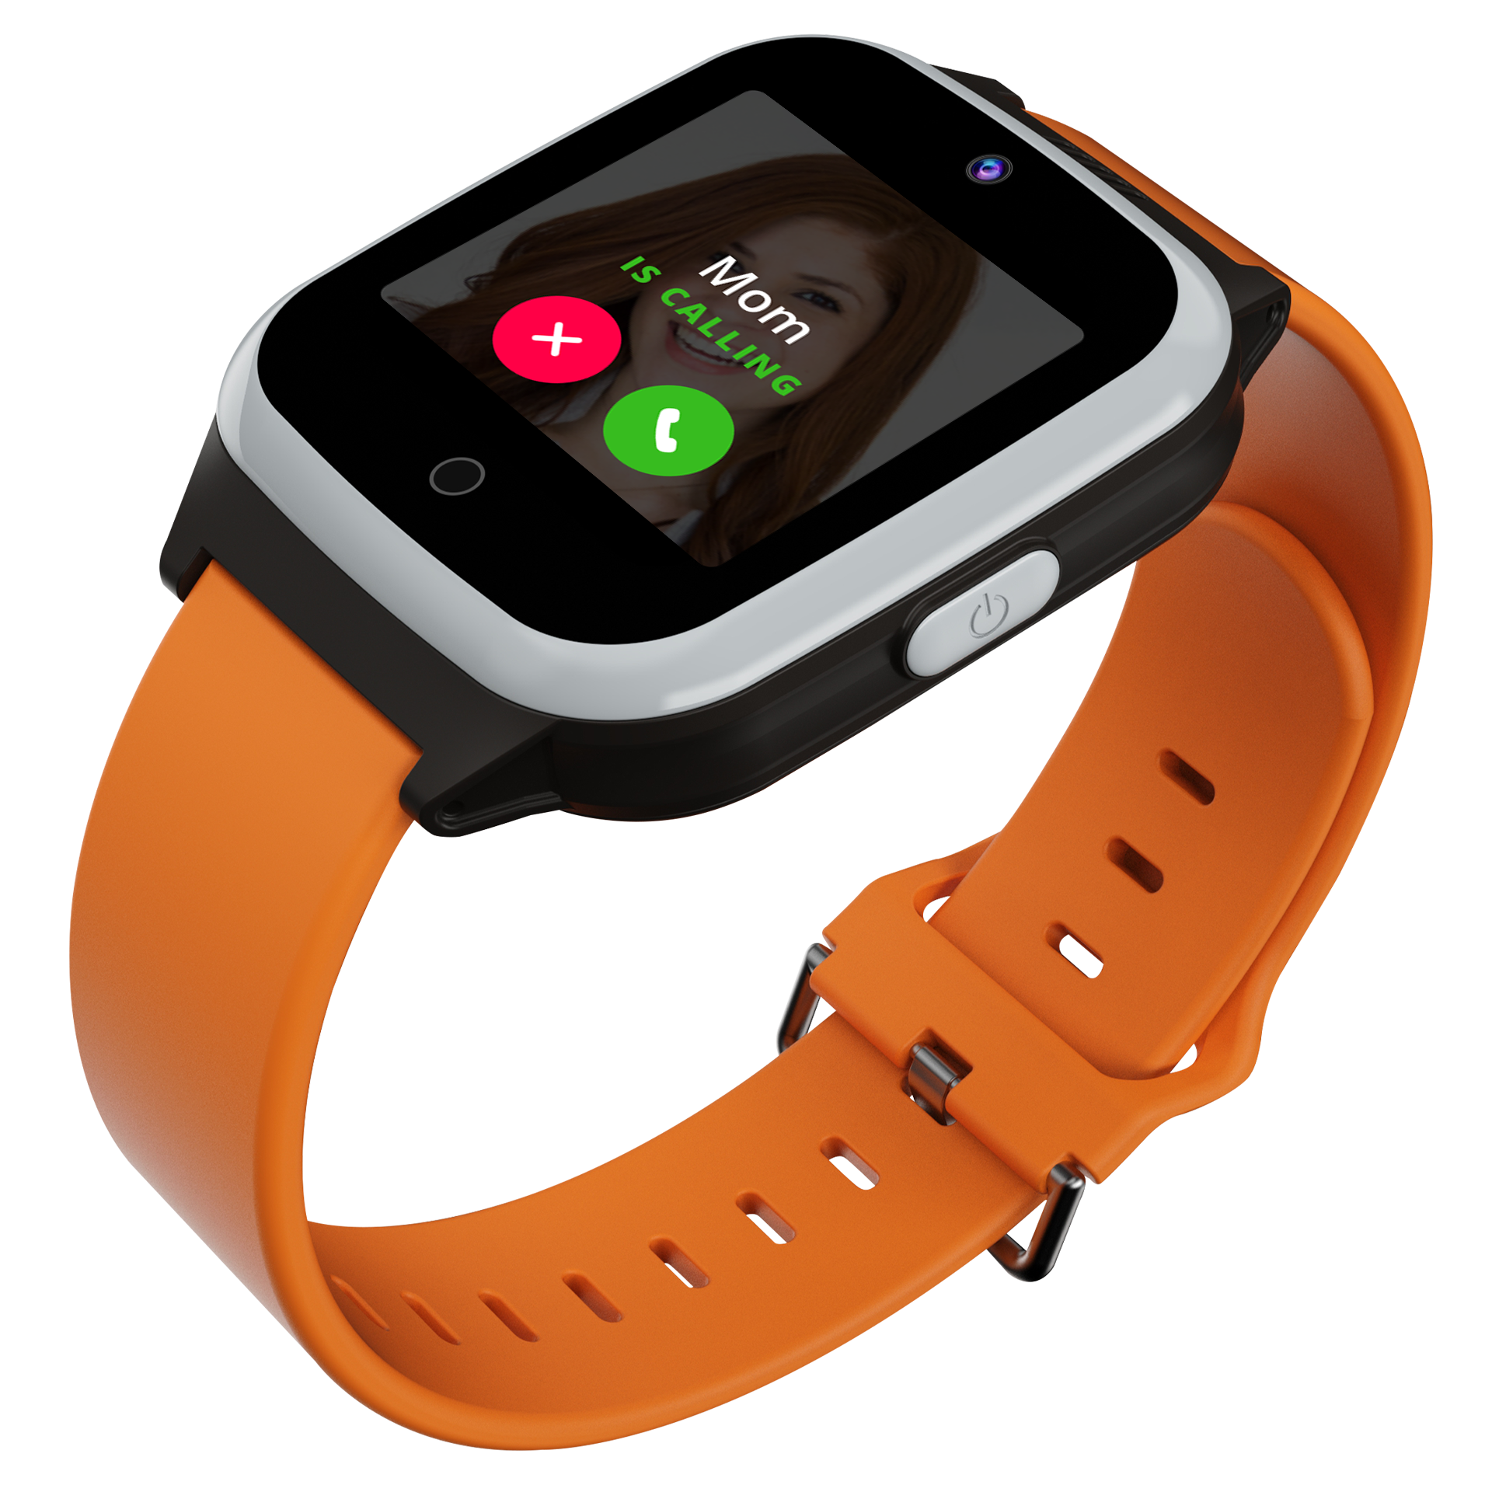
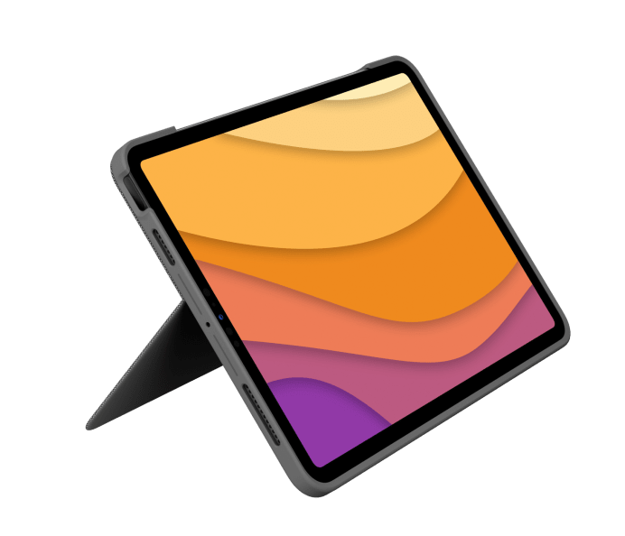
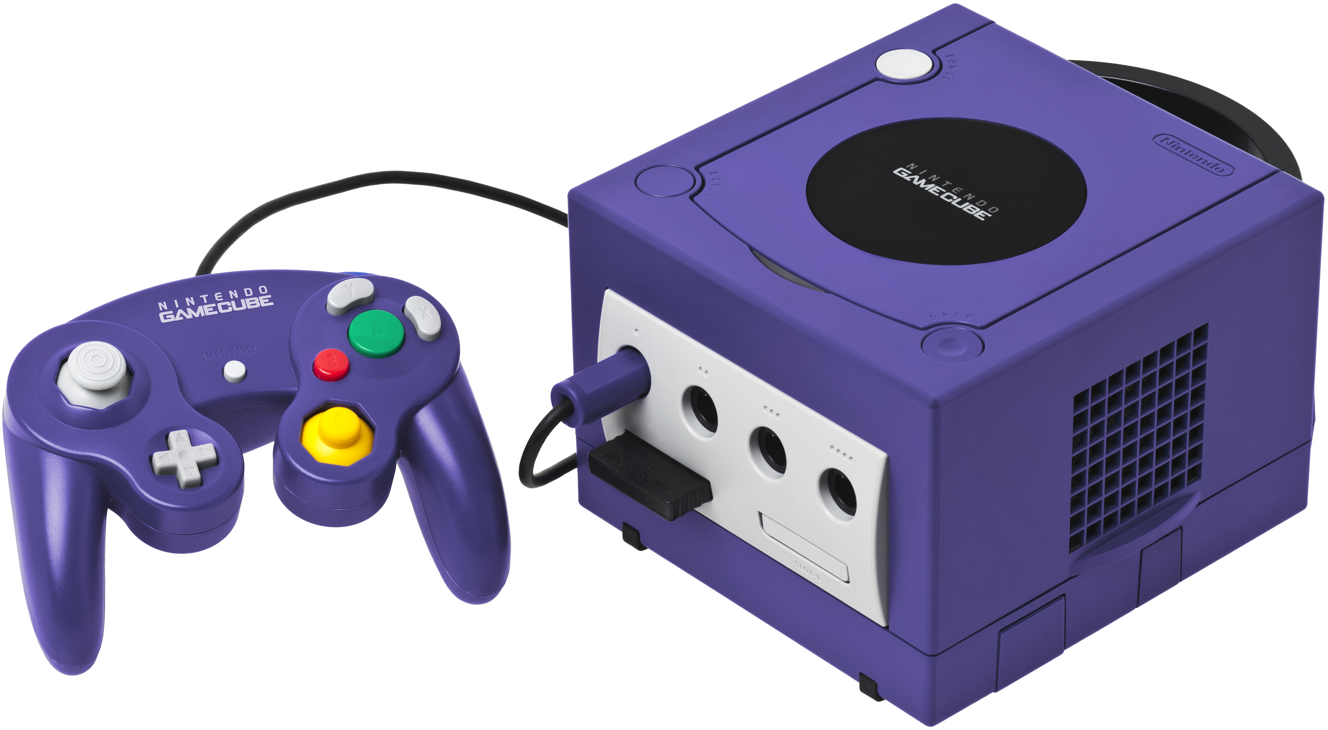
are Everywhere
Computers
What is a computer?
Notes:
Ask the students if they can define a computer
They might think of just a desktop computer, but a computer can be…
A laptop or chromebook
A tablet (like an iPad)
A smart phone (like an iPhone)
A smart watch
A video game console (like a GameCube)
A giant server or data warehouse
A barcode scanner

Slide 12
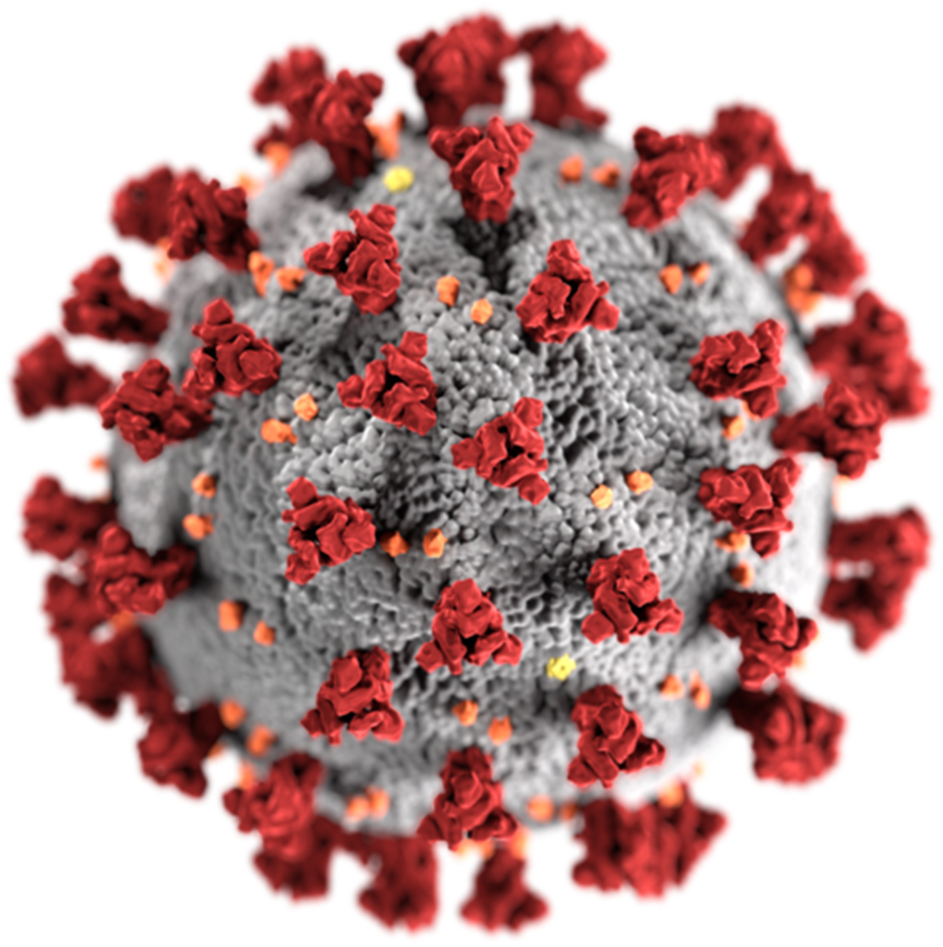

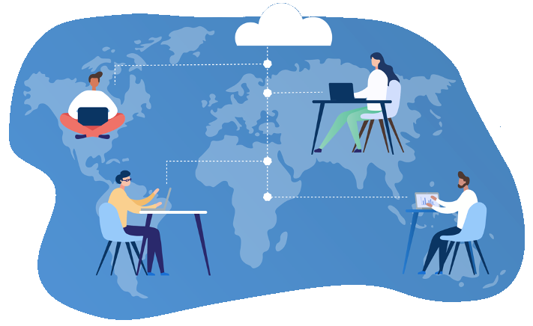
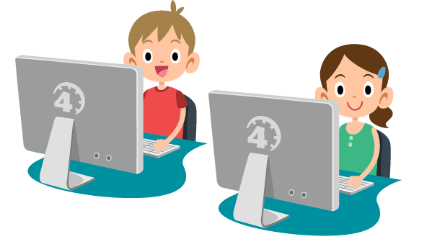

CoViD-19
How did computers affect CoViD-19 lockdowns?
The Digital Divide
The growing gap between people who do not have access to the internet and those who do
How many people across the world
have never used the internet?
What percentage of Cleveland households have no access to the internet (2018)?
2.9bn
27%
Notes:
Ask the students for ways in which computers affected CoViD-19 lockdowns.
Some examples – people were still able to stay in contact via Zoom or Facetime
Not only could families connect, but these tools (along with other software/hardware) also allowed for Remote Learning and Remote Work
However, this didn’t work out well for everyone… ask if anyone has heard of the Digital Divide.
Explain the basic definition of the digital divide – essentially, a lot of people (especially low-income, elderly, and disabled people) do not have access to computers or the internet, while others do
It may be easy to think that everyone has a smart phone, or a home computer, or internet access – but that is far from the truth
CoViD-19 made this divide even more impactful – with “everyone” heading to Zoom, many were left behind
Ask the students to guess how many people across the world have never used the internet
Approximately 2.9 billion people
Think about how this lack of access could affect their lives
Students may be thinking, well that’s just the world, it must be different in the United States…
Ask the students to guess what percentage of Cleveland, OH households have NO internet access (according to a 2018 study)
The answer is a staggering 27%
Ask students why. This generally represents a socio-economic gap, as well as a racial one
Explain that these are just some examples – but the digital divide affects people based on a number of factors
Age
Race
Geography (including rural v. urban)
Income
https://www.theguardian.com/technology/2021/nov/30/more-than-a-third-of-worlds-population-has-never-used-the-internet-says-un
https://cs.stanford.edu/people/eroberts/cs181/projects/digital-divide/start.html
https://www.pewresearch.org/internet/2021/09/01/the-internet-and-the-pandemic/
https://www.usda.gov/broadband
https://www.clevelandfoundation.org/grants/program-initiatives/digital/
https://www.communitysolutions.com/access-denied-impact-clevelands-digital-divide-students/

Slide 13
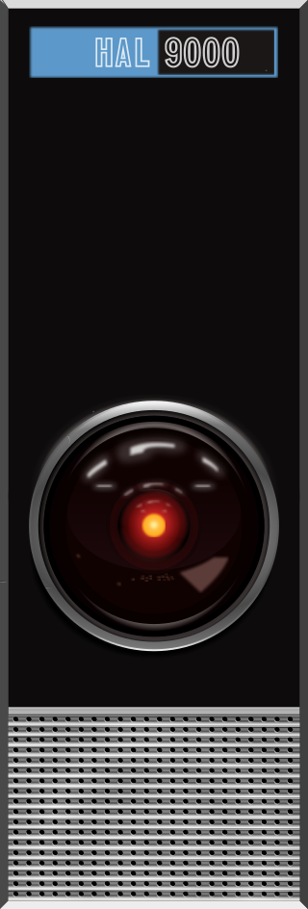
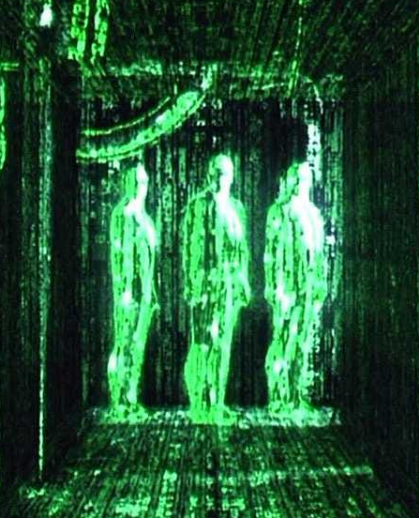
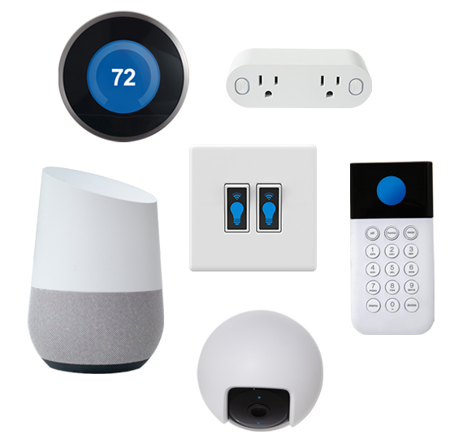
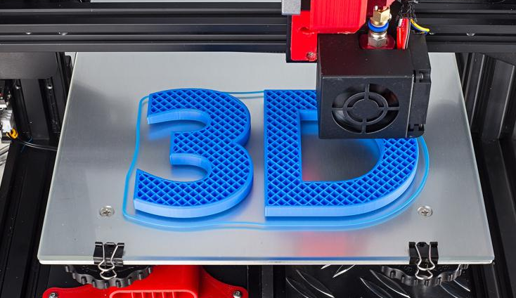
Current Technologies
Artificial Intelligence
Extended Reality (VR/AR)
Smart Devices
3D Printing
Notes:
Ask the students if they can think of current technologies that are impacting our world.
Go over a few of the ones we could dive deeper into later – don’t start to explain them now, but just list them for the students.

Slide 14
Computers in the
Future
How will computers impact us tomorrow?
Notes:
Now we’ve seen a few examples of current technology, and how it has affected society… let’s start to think about where that technology (or new technology entirely) could take us in the future

Slide 15
Types of Technologies
Future
Emerging
Must exist in some way
Must not be “mainstream”
Phases: research, prototype, development, diffusion
Hypothetical
Must not exist at all
Often the subject of science fiction books/movies
Might exist in the future
Examples
self-driving car | VR/AR | androids
quantum computing
Examples
time machine | teleporter
water-fueled car | immortality
Notes:
Let’s start by talking about two distinct types of futuristic technologies
The first is “emerging” – ask the students if they can guess what “emerging” technologies are
There are a few key criteria…
They must actually exist in some way
They must not be “mainstream” – not used by everyone already, like a smart phone or something like that
There are some basic phases:
Research (preliminary stage)
Prototype (actually having some version of the technology)
Development (active work on the technology)
Diffusion (technology works, and is in the process of becoming mainstream)
Ask the students if they can think of examples of “emerging” technologies
(hint: we have covered some of them in this presentation!)
Reveal some examples – some of these are farther along than others, but they are all considered “emerging”
Next, talk about another type of future technology – “hypothetical” – ask the students if they can guess what hypothetical technologies would be
The main criteria here is that the technology must NOT EXIST at all
These technologies are often used in Sci-Fi… but as we know, sci-fi can sometimes turn into sci-non-fi
The fun part is that these technologies might exist in the future
Ask the students if they can think of any examples of hypothetical technologies
Reveal a few examples – time machines and teleporters will probably never exist, but water-fueled cars and immortality via life extension may be possible
Or, who knows, anything might happen or not happen

Slide 16
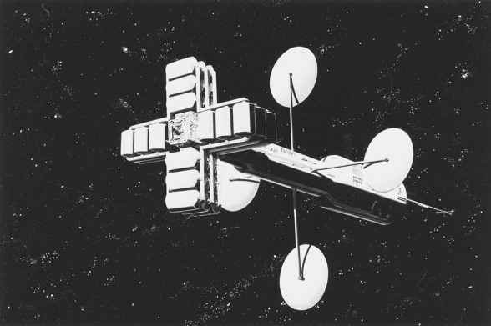
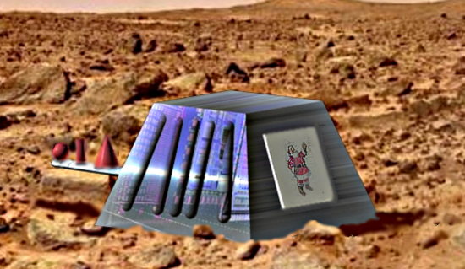
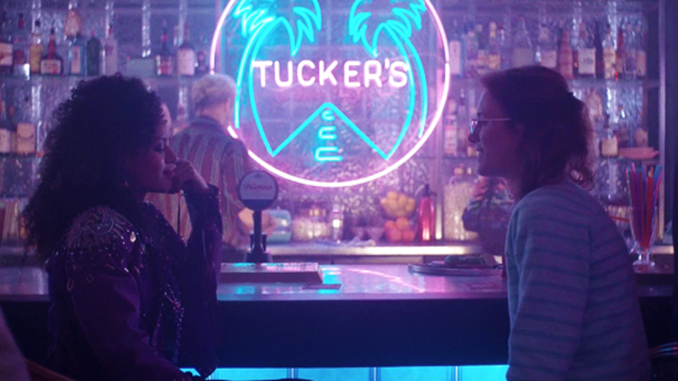
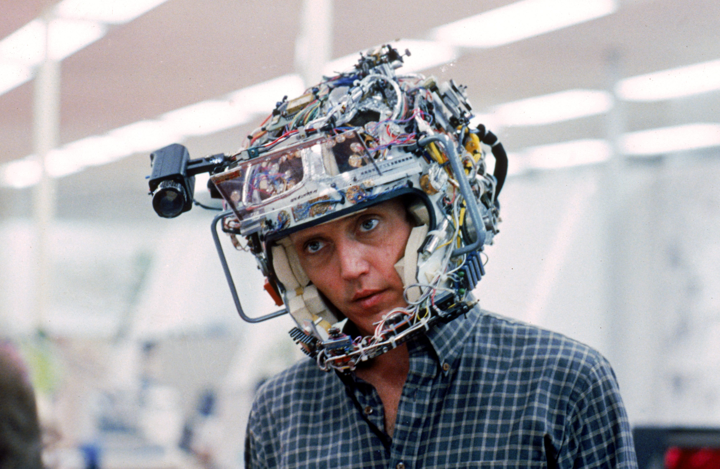
Examples – Hypothetical Tech
Molecular Nanocomputers
Really tiny computers capable of working at the atomic level
Santa Claus Machine
Von Neumann Probe
Whole-Brain Emulation
Scanning a physical human brain and recreating it entirely in a digital form
Digital Immortality
Thought Recording
Notes:
The point of this slide is simply to throw out a lot of ideas for things that could exist in the future – their feasibility is definitely in question
One big area that could lead to a lot of interesting developments is molecular computers – read the definition
These nanocomputers could be used to create something like a Santa Claus Machine
This machine could take in any form of matter (rocks, dirt, etc), rearrange the molecules, and create any other object
Taking that a step further, there is the Von Neumann Probe (pronounced NOY-man) – a self-replicating spacecraft
These probes could explore the far reaches of the galaxy, landing on planets, harvesting resources, and rebuilding themselves
Another interesting topic is whole-brain emulation – the idea of taking a human brain and representing it in a digital form
One thing that could arise from that would be mind uploading
Like the San Junipero episode of Black Mirror, this could lead to digital immortality
Another potential application would be thought recording
If you can represent a brain, you can represent experience, and maybe even share your experience with others… what would the consequences be?

Slide 17
Summary
Wrapping things up
Notes:
Well, at this point, a lot of different topics have been covered, and hopefully they’ve made you think a little bit. Let’s go over everything we discussed

Slide 18
Summary
Past
Primitive computers, A.I., the internet, and other digital technology has impacted our culture, economy, and society
Present
Current computer technologies like smart phones, A.I., blockchain, VR, and more continue to impact society
Your Impact
As a member of Gen Z (aka a Zoomer), you will have the opportunity to work with new technologies and shape the future of our world
Future
Emerging technologies and hypothetical technologies will have an impact on society as they evolve
Notes:
Go through a brief summary of the presentation
Talk about how computers have impacted society in the past
Ask the students for examples
Ask the students for a take-away about computers in the past
Talk about how computers currently impact society
Ask the students for examples
Ask the students for a take-away about computers in the present
Talk about how computers and new tech will impact society in the future
Ask the students for examples
Ask the students for a take-away about computers in the future
Emphasize that the students themselves will be the ones who will really have the opportunity to work with these new technologies - their generation will be the one that has the biggest impact

Slide 19
THANK YOU!
WHAT QUESTIONS DO YOU HAVE?
Hyland Hy-Tech Camp

